Slide 1



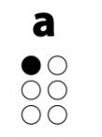
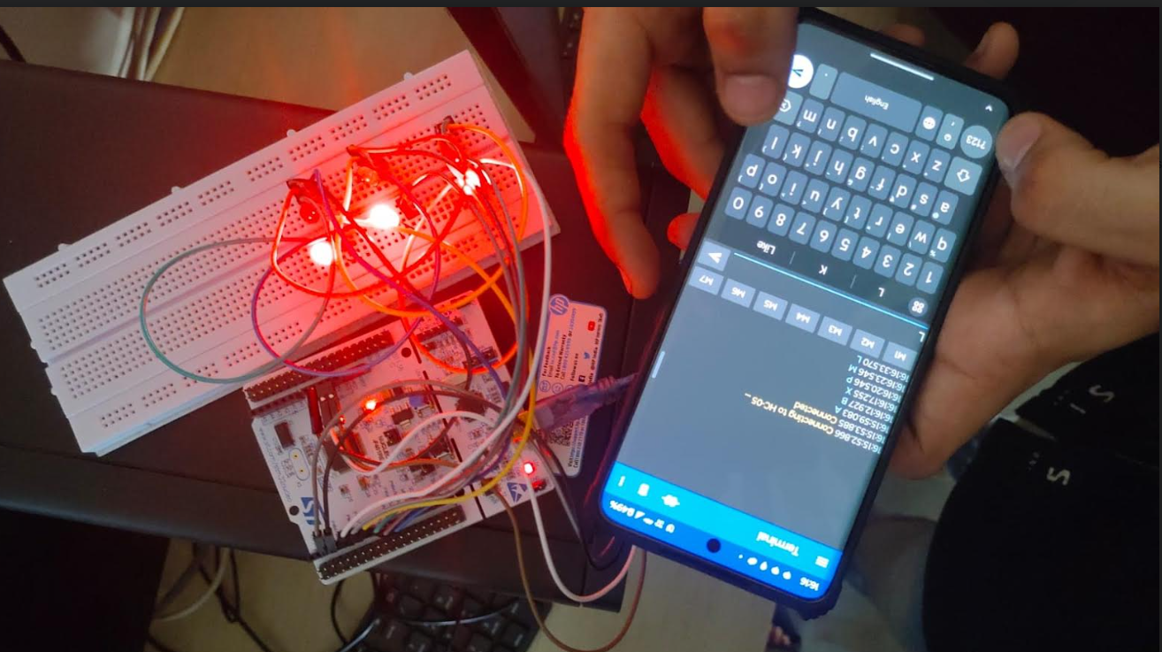

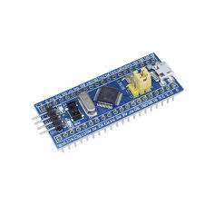

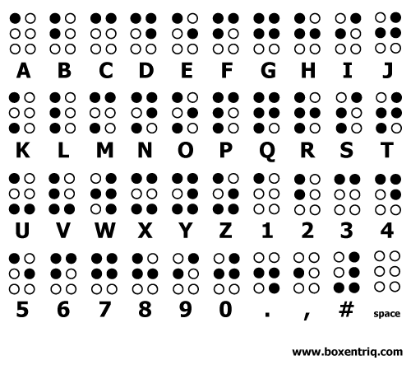
Inter University Research Convention-Avishkar 2023-24
Text To Braille Converter
Category: 1
Humanities ,Languages and Fine Arts .
Level :
U.G
Abstract
block diagram
RESULTS
The "Text-to-Braille Converter" minor project aims to enhance accessibility for the visually impaired by developing a user-friendly system. Leveraging advanced NLP techniques, the converter analyzes and converts standard text into Braille patterns, prioritizing efficiency and accuracy. Key features include adaptability to various input formats, multilingual support, and a seamless interface for both sighted and visually impaired users. This project aligns with inclusivity goals, empowering individuals with visual impairments to independently access educational, professional, and recreational content. The Text-to-Braille Converter is a crucial step toward bridging the accessibility gap and fostering equal information access.
Text as Input
Braille
Application
Micro-
controller
Introduction
Bluetooth Transmission
Bluetooth
Module
The "Text-to-Braille Converter" project emerges as a crucial endeavor in the realm of accessibility technology, addressing the persistent challenges faced by visually impaired individuals in accessing textual information. In a world inundated with printed and digital content, the visually impaired often encounter barriers hindering their independent information retrieval. This project proposes the development of a sophisticated system that employs advanced natural language processing techniques to convert standard text into Braille, the tactile writing system widely used by the visually impaired. With a focus on efficiency, accuracy, and user-friendliness, the Text-to-Braille Converter aims to empower individuals with visual impairments, enabling them to seamlessly access diverse textual information and fostering a more inclusive and equitable digital landscape.
Results
Algorithm for controller synthesis
Input: Receive a string of standard text as input.
Text Analysis:
a.Break down the input text into individual words.
b.Identify the language of the text for appropriate translation rules.
Character-to-Braille Mapping:
Create a mapping table that associates each standard character with its corresponding Braille pattern.
Word-to-Braille Conversion:
For each word in the input text:
i. Break down the word into individual characters.
ii. Use the mapping table to convert each character into its Braille equivalent.
iii.Concatenate the Braille representations of individual characters to form the Braille pattern for the entire word.
Sentence Structure Handling:
a. Identify sentence boundaries and apply appropriate Braille indicators.
b. Consider any necessary formatting for conveying the structure of the original text in Braille.
Output Generation:
Concatenate the Braille patterns of individual words to generate the final Braille representation of the entire input text.
PROBLEM STATEMENT
Visually impaired individuals encounter obstacles in accessing standard text, impeding their autonomy in a text-driven society. Existing text-to-Braille solutions lack adaptability, language support, and user-friendliness. This project addresses the need for an efficient and accessible "Text-to-Braille Converter" to empower visually impaired individuals, ensuring equal access to educational and informational content.
Conclusions
In conclusion, the Text-to-Braille Converter project successfully addresses the accessibility gap for visually impaired individuals. The developed solution offers an efficient, adaptable, and user-friendly tool for converting standard text into Braille patterns. With a focus on accuracy and multilingual support, the converter has demonstrated its viability for widespread use, including educational integration. Ongoing commitment to user feedback, community outreach, and accessibility compliance ensures continuous improvement and broader impact. This project represents a significant step towards fostering inclusivity and empowering visually impaired individuals in their access to information and educational resources.
OBJECTIVES
Efficient Conversion: Develop a Text-to-Braille Converter that efficiently translates standard text into Braille patterns, ensuring a swift and accurate conversion process.
Educational Integration: Explore opportunities for integrating the converter into educational settings, facilitating improved access to educational materials for visually impaired students.
Community Outreach: Conduct awareness campaigns and workshops to promote the Text-to-Braille Converter within the visually impaired community, educational institutions, and relevant organizations, fostering widespread adoption and feedback.
User-Friendly Interface: Create an intuitive and user-friendly interface to cater to both visually impaired and sighted users, enhancing accessibility and promoting widespread adoption.
references
https://www.pharmabraille.com/pharmaceutical-braille/the-braill
e-alphabet/?fbclid=IwAR3SS8YF3_kZux5v6bnNMNo-wnpGoh1GB50
j5e2kXFpupc16m87o4xzOChY
https://libbraille.org/how-alphabets-and-numbers-are-written-in-th
e-script/ https://www.st.com/resource/en/data_brief/stm32cubeide.pdf
Code No:
Notes:
1

